Slide 1
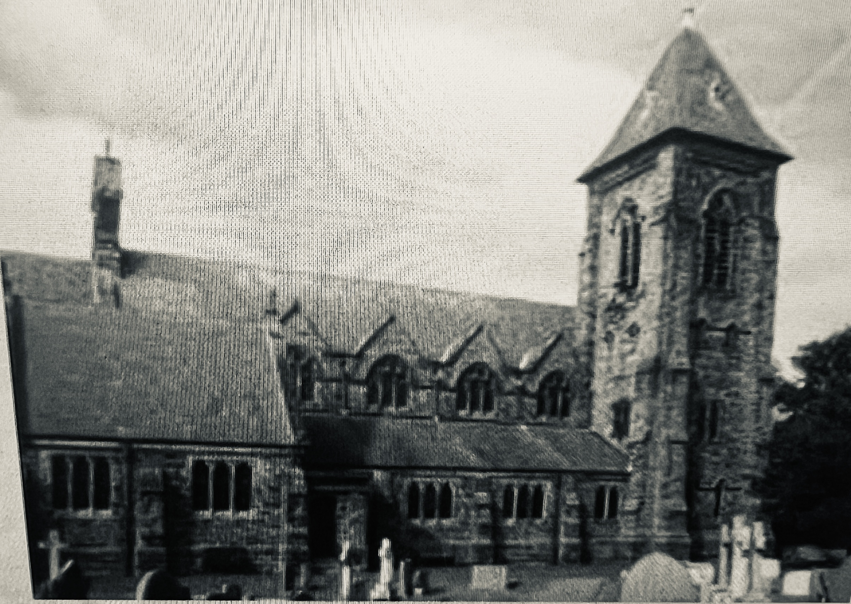



St Marys Catholic
Primary School
PTFA Newsletter September 2023
What we have raised since September!
Dates for the Diary
£6,753!!!!
10th Oct Homeless Collections - School Event
18th Oct Autumn Movie Night
30th Oct Pumpkin Competition
3rd Nov Xmas Jumper Amnesty
13th Nov Odd Socks Day – Anti-Bullying
17th Nov Children in Need Mufti
24th Nov Christmas Carol Play
1st. Dec Sponsored Santa Dash – Pet Sale/Jumpers/Refreshments/Lockabox
7th Dec Xmas Jumper Day for Xmas Choc/selection boxes
13th Dec Xmas Bingo
15th Jan School Bake Off
2nd Feb Number Day – School event
6th March Mothers Day Shop
7th March World Bk Day – PJs for Easter Eggs
20th March Easter Bingo
21st Mar Odd Socks Day Down Syndrome
28th Mar Easter Hat Parade
23rd May Spring Movie Night
24th May Mufti for Teddies
13th June Fathers Day Shop
28th June Mufti for Bottles
29th June Summer Fair
5th July Sports Day
23rd July Ice Cream Truck
Movie Nights £317
Pumpkin Competition £24
Santa Dash £2,500
Christmas Jumpers £30
Pet Toy Sale £319
Mufti Day £30
Osborne & Smithy Shop £178
Bake Off £34
Sponsored 2023 £594
Mothers Day Shop £139
Easter Bingo & Parade £261
Fathers Day Shop £129
Refreshments etc £193
Summer Fair £2004
Can you Help Us?
We need volunteers for our
Movie Night from 2.30pm
Santa Dash from 12pm
Xmas Raffle Hamper Donations
Committee
Chair
Laura Loveday
Treasurer
Nicola Gray
Secretary
Heather Parsons
Vice Chair
Vacancy

Slide 2





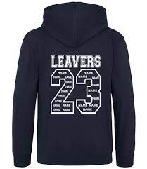
St Marys Catholic
Primary School
PTFA Newsletter September 2023
This year we have spent £3,607
A Huge £2,176 was contributed to the school trips to Imagine That & Eureka, including the coaches.
Miscellaneous £125
Eg Various Prizes, Parent kind membership (insurance), Sum Up Machine
PTFA Freezer & Urn £219 – to keep our frozen treats ready on site so we can take advantage of hot spells short notice and the Urn to support all events where refreshments are sold….
£865 Treats for our children like Wonka Bars, Ice Cream Trucks, Charles Dickens Christmas Play etc
Year 6 Leavers Hoodie Contribution. £222

