Slide 1

Year 2 & 3
Mrs Priestner
Mrs charnock

Slide 2
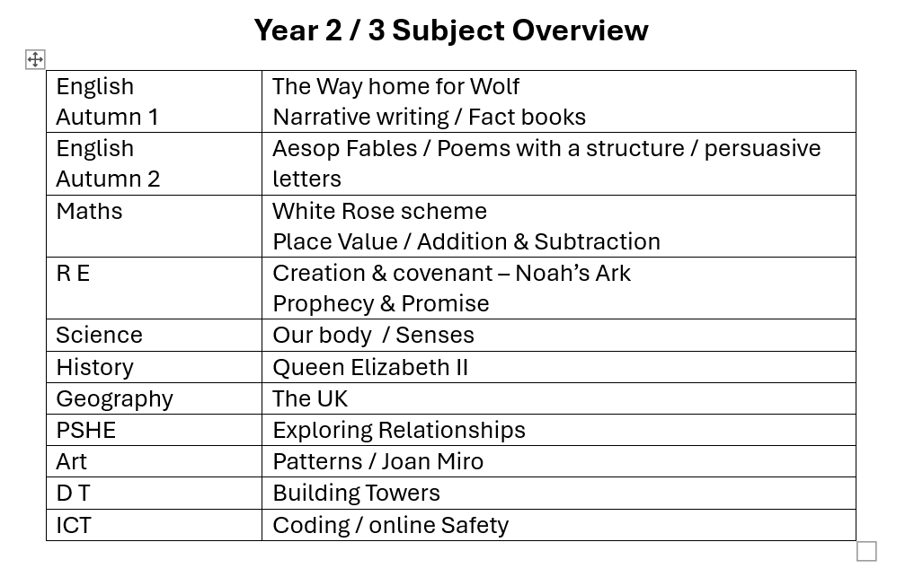
Subjects

Slide 3

SCIENCE
As the Science curriculum is very different for KS1 and KS2 we have decided to have the whole school doing Science lessons on Tuesday afternoons.
The children will be split into 4 groups: Nursery & Reception / Y1 & 2 / Y3 & 4 / Y5 & 6
This will ensure that all aspects of each curriculum are taught and skills can be developed and built upon in each age group.

Slide 4

Reading
Reading is very important at this stage of your child’s education – reading as often as possible will help to improve fluency and comprehension.
Reading will be helpful in learning spellings and giving story writing ideas.
Reading teaches us about different sentence types that we can use in our writing.
Please practice with your child as often as you can and return the book to school every day – this will help children to move up on our reading challenge and see their own achievements.
Year 3 children should be at around stage 9 and Year 2 at around stage 6 to be at the correct stage.

Slide 5

Homework
Each Friday the children will receive a homework sheet.
Spellings – please learn these at home ready for a test on the following Friday. (We will also practice these in school but only as time allows)
Times Tables – these will also be tested on a Friday morning. (These will relate to the times tables that we are practicing at school and the aim is to have fast recall of multiplication and division facts for each times table.
Y2 will need to know 2, 5 and 10 times tables and Y3 will extend this to 3, 4 and 8 times tables.

Slide 6

Physical education – PE
This half term PE is on a Wednesday afternoon (Athletics) and a Friday morning (Outdoor Adventurous Activities).
Athletics after school club is available for the Y3 children every Wednesday of this half term.
After half term PE may change so watch out for the information on the school newsletter.

Slide 7
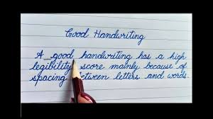
Handwriting
Children will be encouraged to used a neat style of handwriting in all of their work and we will practice using joined handwriting as we progress through the year.
If your child needs support with this, then please help them to form their letters correctly as this will make it easier for them to do joined writing later on.

Slide 8

Purple Mash
Every child has a Purple Mash login that they can use at home.
Our spellings for Year 3 are on this – there are quizzes and worksheets for learning the spellings.
Our ICT lessons are on this – our first topic is CODING. The children can access all the activities at home to practice. They come with power points, instructions and video help.

Slide 9
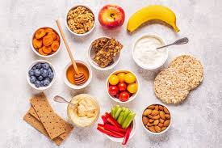
Water bottles & snacks
Please make sure that your child has a water bottle in school everyday. If they wish to leave this in school, they can and can fill it with fresh water every morning.
Snacks – These must be healthy and nut free – please do NOT send in crisps, biscuits, chocolate or sweets as they will not be able to have these snacks.

Slide 10
Uniform / Attendance
Don’t forget that we have a selection of pre-loved uniform in the front office so if you need any spare uniform, please help yourself.
It is really important that the children have a good attendance as missing school means missing important concepts and this will have an impact on future learning. Please think before planning activities or holidays in school time!

Slide 11

Any Questions?

